Slide 1
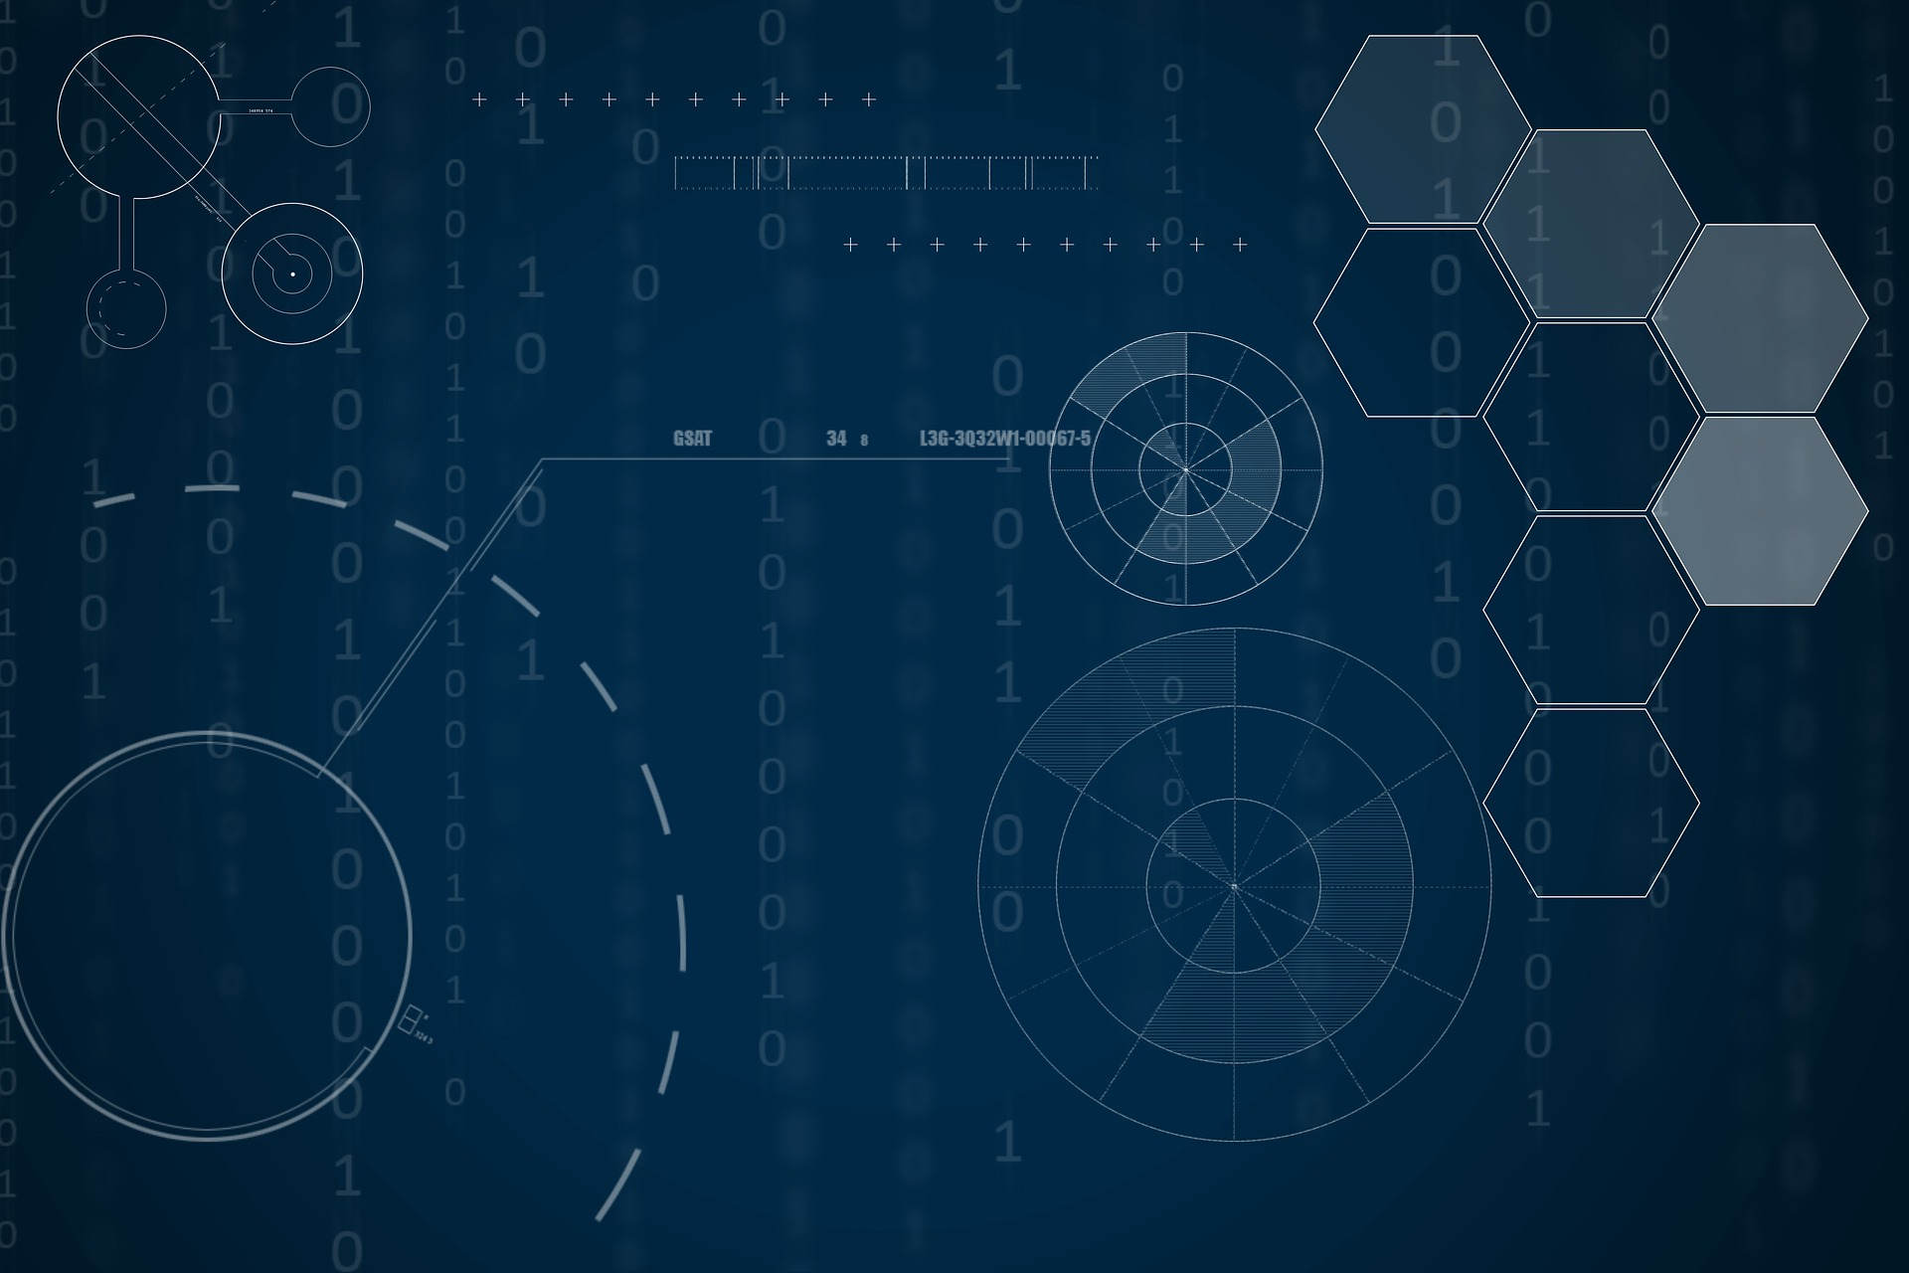
Patient Health History Record System
- By Siddhesh Kulthe

Slide 2

Introduction
The medical sector is growing on a huge scale day-by-day. So, is the date present in this sector. And management of this prestigious data; is something neglected right from the start. To overcome this hurdle is the main motive of this project.

Slide 3
Use Case of Choice
The health system's monitoring of the patient's life and needs will be safer and more reliable. The patient and the doctor will be able to access the results of procedures on their cell phones or computers without having to search the places where they were made. This would make the patient have a quick medical response in the event of an emergency. It would also be possible for doctors to form a group at a given moment and be able to exchange information about the patient if necessary.
Solution
If a patient discovers that he has diabetes and at the same time his nutritionist receives the exam sent by his doctor and already updates his diet in minutes. If the patient arrives for care in an emergency situation, without being conscious, the doctor who attends him will be able to access his data using a standard password linked to his ID. After the appointment, the patient or his family will be able to confirm or not the state of emergency. The patient will be able to interact his data with Artificial Intelligence models to generate possible diagnoses of diseases that can be developed during his life. From a medical point of view, patient care will be safer and faster. In emergencies, decisions can be made based on more reliable and secure data. All procedures can be accessed at any time, making service faster, safer and more reliable. It would also increase the number of patients seen thereby speeding up the waiting line. In the use of e-Health the doctor would have complete safety and reliability in treating a patient even at a distance with more accurate and updated data.

Slide 4
Solution
From the government's point of view, this project aims to meet the demands of the most vulnerable population in relation to public health needs in order to maximize hospital care and subsidize decisions aimed at better targeting public health policies. The government will be able to better target medical specialties according to the demands of the population. For example, identifying that a community with a majority of elderly people does not offer support from a geriatrician. Logistics can be maximized by sending supplies to places that really need them, such as a greater amount of flu vaccines where there is a higher incidence of this disease. Health studies may use Artificial Intelligence models to discover where there is a greater possibility of such diseases according to the health situation of a given region. In the event of an emergency such as an outbreak or epidemic, the government could quickly learn and take the necessary measures in relation to the vulnerable population.

Slide 5
Technology
This project uses two methodologies: BOLCKCHAIN and DATA LAKE
BLOCKCHAIN - Used in the patient database for validation and authenticity.
Validation: For a record to be valid, it must be authenticated by the participants as doctors, hospitals, nurses and all professionals involved in the process and always with the patient's visa.
Authenticity: The records are NEVER deleted, that's why it is called "Patient Health History Record System", ALL the patient's life data is stored. In the event of a record error, another record will be created linked to the record to be rectified and also validated by those involved.
DATA LAKE - Used in the patient's database so that we can store any type of data in the patient's record. We can store videos of remote consultations, audio of the patient in an evolution of symptoms during a period, images of exams and medical prescriptions, among other information.

Slide 6
Scaling
The project deals with the management of historical patient data. The idea is to develop a Data Lake (a repository of structured, semi-structured and unstructured data) that stores patient data. The advantage of Data Lake is that it is possible to associate with structured data (an existing database), unstructured data, such as exam images, etc. In addition, it is possible to apply machine learning techniques to this data. It is a data integration environment without all the cost of multidimensional databases, such as Data Warehouses and Data Marts. From that Data Lake, the plan is to develop a system that is able to manage / query the data. We will also use BLOCKCHAIN ​​technology in this database to have authenticity and validation of the information in the data provided. In short, an updated, reliable, secure and managed database with data and information from patients and their doctors. The use of Data Lake technology means that this project can be used anywhere in the world in the same way. Finally, we can use public health in disease control in a coordinated way around the world and directly help those who need it most in times of pandemic, and we can design future disease outbreaks through artificial intelligence and mathematical projection models.

